Slide 1
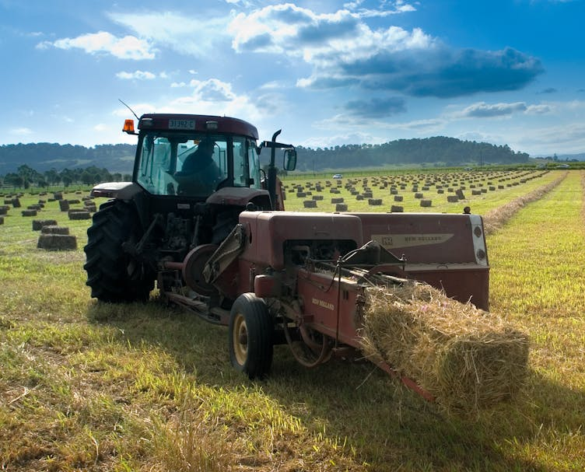
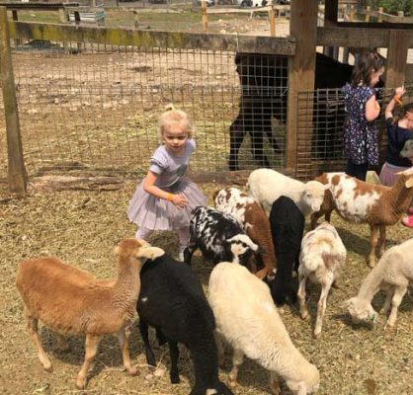
Agritourism Workshop
Today's Agenda:
7.30am - Arrival and breakfast
7.40am - Welcome and acknowledgement
7.45am - Council Presentation
8.20am - Case Study: Nimbin Valley Dairy
8.30am - Questions and answers
9.00am - Close

Slide 2
Business Support
We are committed to engaging with local businesses to ensure the right information and resources available to establish, grow and diversify. The Destination and Economy team support new and established businesses, delivering:
Business advice (approvals, licences, permit requirements)
Engagement and networking opportunities
Connections to other support agencies both State and Federal; and
Business precinct activation
For support and guidance along your journey, connect with:
Tina Irish, Manager Destination and Economy
Phone: 02 6625 0458 / 0427 003 645
Business@lismore.nsw.gov.au

Slide 3
Agritourism reforms
State Government changes
In late 2022, new fast-track agritourism pathways were introduced for:
Roadside stalls
Farm gate premises*
Farm experience premises*
Farm stay accommodation*
* Must be on a commercial farm and ancillary to the farm

Slide 4
Agritourism reforms
State Government changes
Three pathways available, depending on type of development and scale:
Exempt development – no planning approval required
Complying development – fast-track planning approval through Council or private certifier
Development application – standard DA procedure through Council
Notes:
While no planning approval is required for exempt development, other Council approval may be required

Slide 5
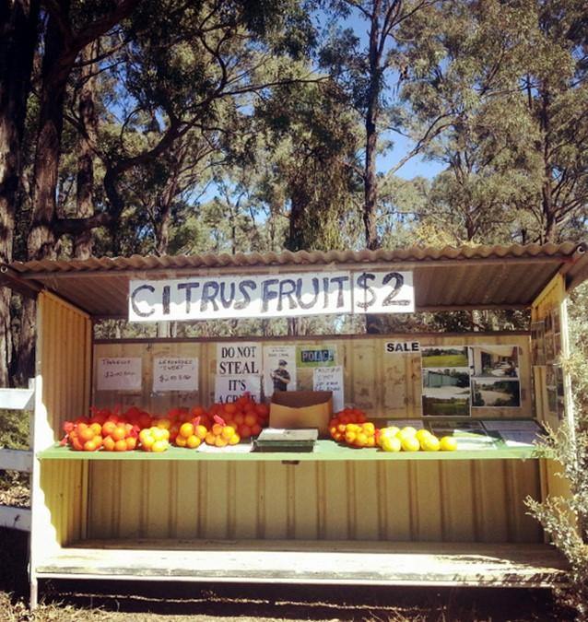
What can you do?
Roadside stalls
Able to sell agricultural produce or hand-crafted goods from your property or adjacent property
Up to 9m² as exempt development (no DA required)
Up to 15m² through DA
Parking on-site, or verge in some cases

Slide 6
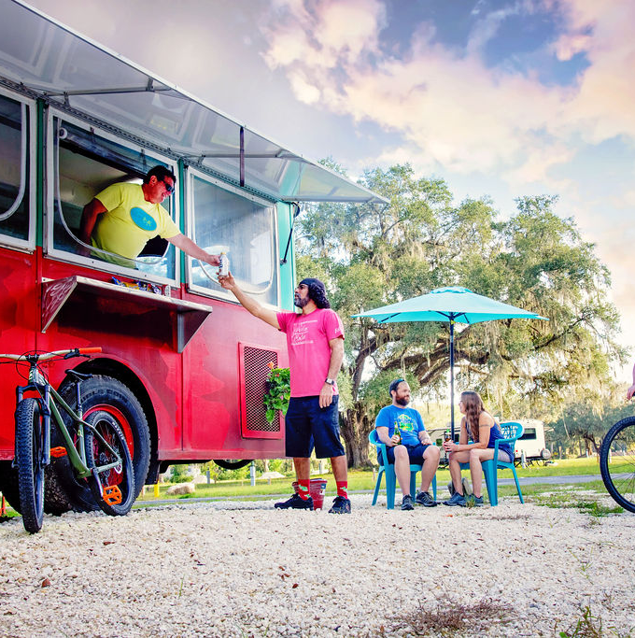
What can you do?
Mobile food and drink outlets (food trucks)
Up to one food truck as exempt development
On your land or with owner’s consent
Not necessary to sell produce from farm
While no planning approval required, Council permit still required
Notes:
Requirements for Council under Local Government Act 1993 and NSW Food Act 2003.

Slide 7
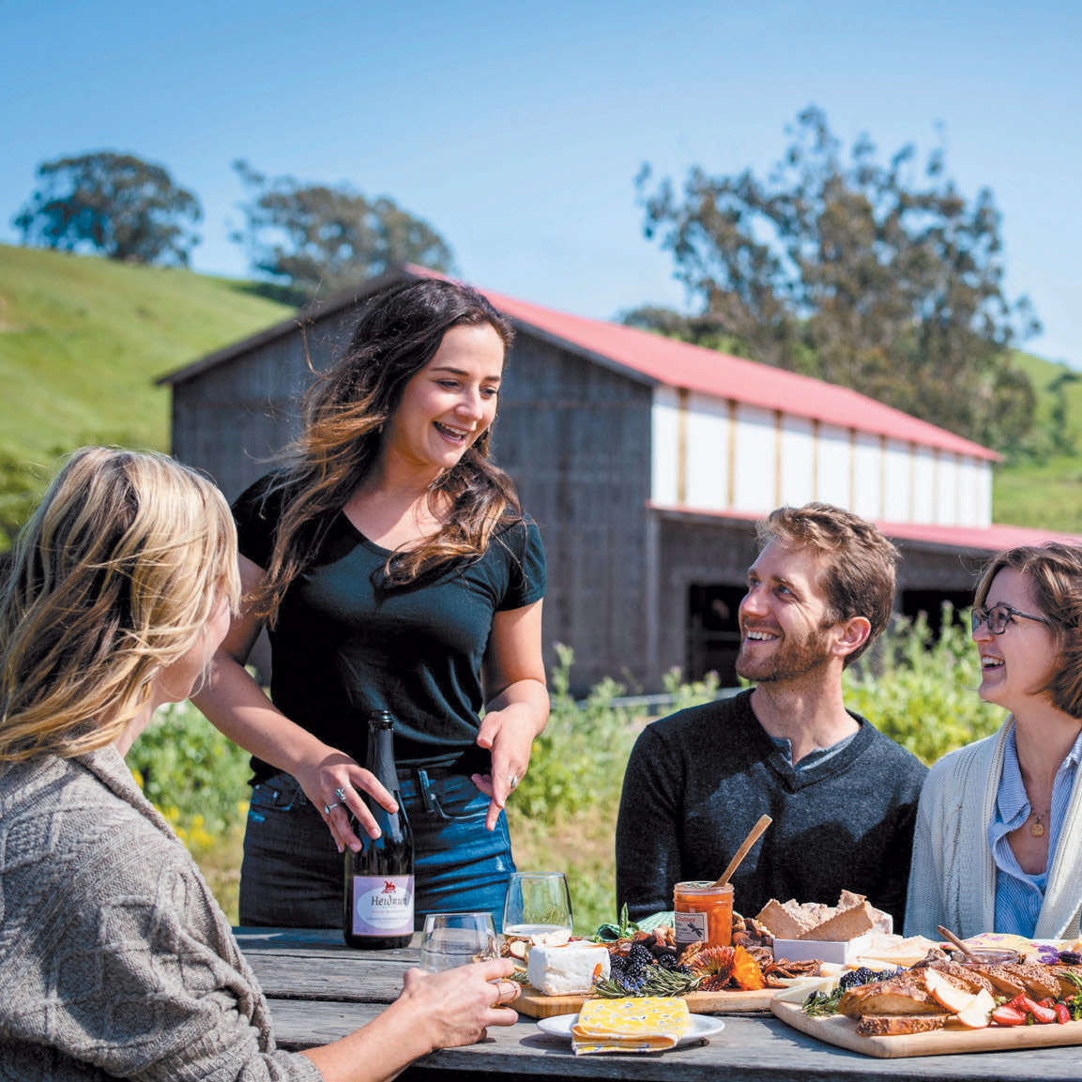
What can you do?
Farm gate premises
Providing visitors with agricultural products mostly from farm
Includes:
Processing, packaging and sale of products
Preparation and serving of food and drink
Tastings or workshops
Information and education
Notes:
Must be on a commercial farm and ancillary to the farm

Slide 8
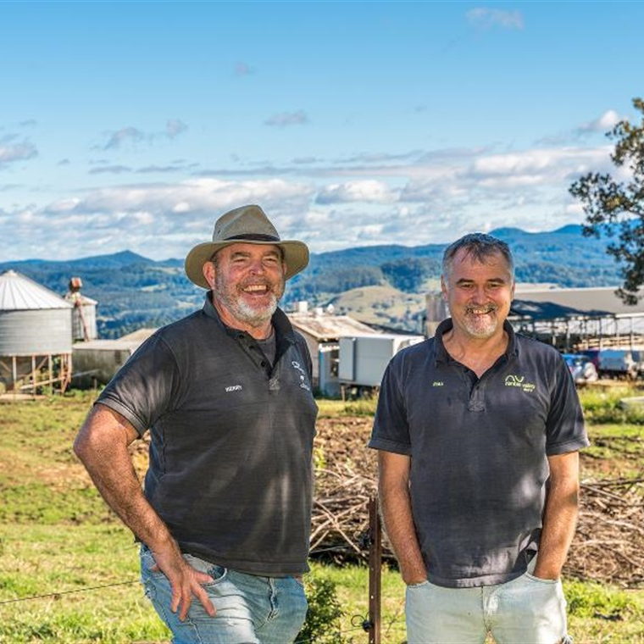
Farm gate premises
Exempt development:
Up to 200m² of existing building
Max 100 visitors (excluding fruit and produce picking)
Complying development:
A new building up to 200m²
Max 100 visitors
Development application:
A new building up to 300m²
Max 100 visitors
Notes:
Again, requirements of Local Government Act and Food Act mean that you will need Council approval for selling food, sewage, water and waste, even if exempt development.

Slide 9
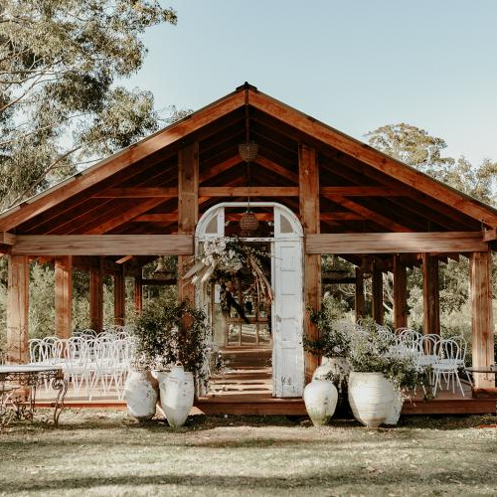
What can you do?
Farm experience premises
Small-scale and low-impact tourist or recreational activities including:
Horse riding
Farm tours
Functions and conferences
Farm field days
Yoga, art or cultural workshops, weddings
Notes:
The activities must be on a commercial farm, and ancillary to the farm.

Slide 10
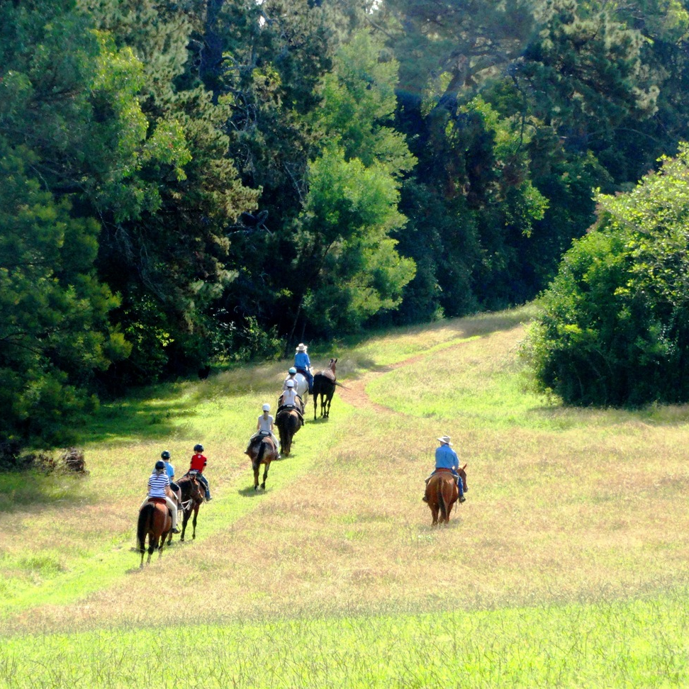
Farm experience premises
Exempt development:
Up to 200m² of existing building
Max 50 visitors
Complying development:
A new building up to 200m²
Max 50 visitors
Development application:
A new building up to 300m²
Max 100 visitors
Notes:
Again may need Council approval for food safety, sewage and waste

Slide 11
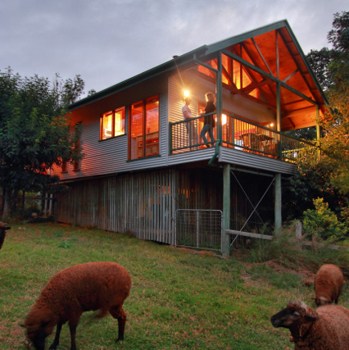
What can you do?
Farm stay accommodation
Provides accommodation to paying guests of the farm, including in buildings or moveable dwellings
Notes:
Must be on a commercial farm, and ancillary to the farm

Slide 12
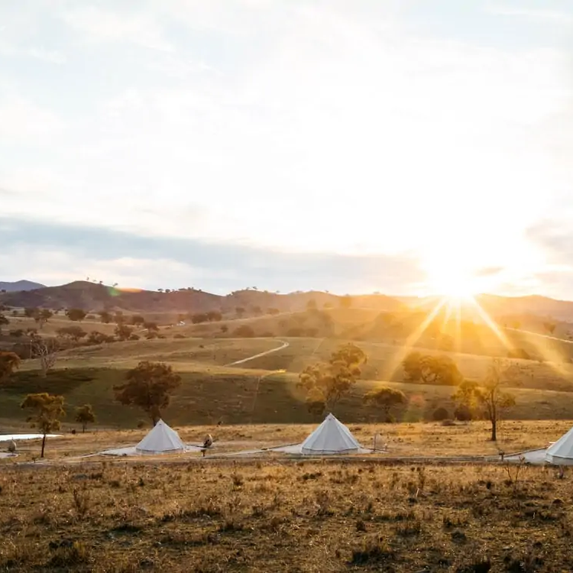
Farm stay accommodation
Exempt development:
Up to 20 guests in tents, caravans and campervans
Can use up to 60m² of existing accommodation
Minimum landholding of 15 hectares, 21-day stay limit
Complying development:
Up to 20 guests in 6 new buildings (1 per 5 ha)
Max 60m² each, min holding of 15 ha, 21-day limit
Notes:
Again, may need Council approval for sewage, water and waste. Campgrounds and caravan parks need approval through Local Government Act (s68 certificate)

Slide 13
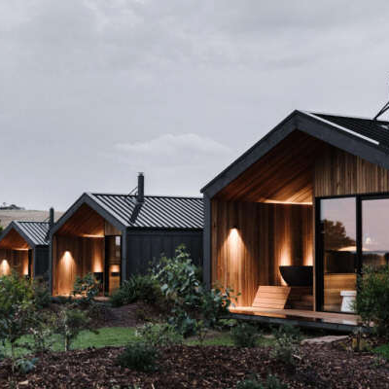
Farm stay accommodation
Development application:
Up to 6 buildings (only 1 per 5ha)
12 bedrooms max overall
Max 60m² plus 15m² external (verandahs etc)
90-day maximum stay
Notes:
Again may need Council approval for food safety, sewage and waste

Slide 14
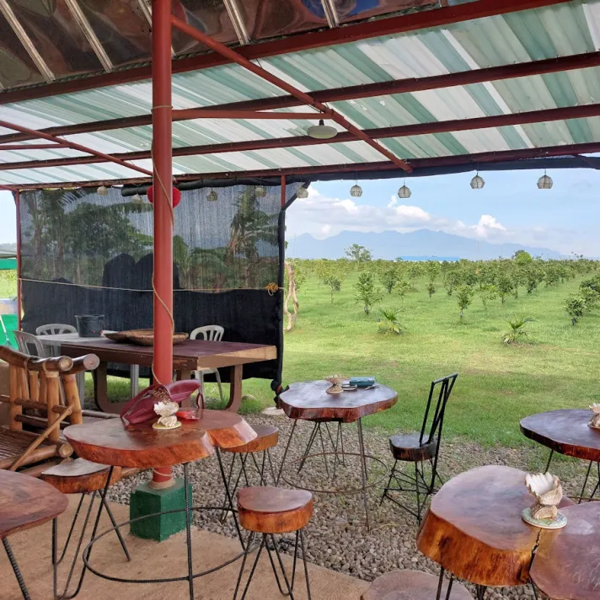
What requires a DA?
Doesn’t meet exempt or complying requirements
Restaurants or cafes – does not require farming operation, or produce from onsite
Kiosks – up to 50m² to sell food, light refreshments and other small convenience items
‘Other’ tourist and visitor accommodation
Notes:
Council has a DCP Chapter ‘Rural and Nature-based Tourism’ that details the requirements for tourism development that requires a DA

Slide 15
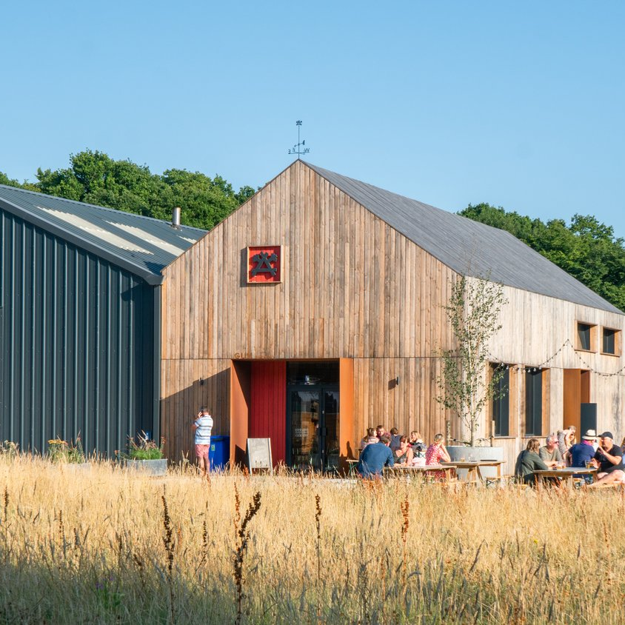
Potential future changes
Council is investigating including ‘artisan food and drink industries’ as permissible with consent in RU1 zone
Includes craft breweries, distilleries, cheesemaking etc.
Notes:
If Council endorsed, scheduled for 2025

Slide 16
Agritourism Reforms
Environmental & Public Health
Councils Regulatory Services section can assist the following approvals and processes.
On-site Sewage Management
Contaminated Land Assessment
Food Premise Registration
Land use conflict buffers
Noise management

Slide 17
Agritourism Reforms
Environmental & Public Health
Exempt and complying approval pathways do not exclude you from getting the following approvals.
A section 68 under the Local Government Act to install/alter/upgrade a sewage management facility or install plumbing and drainage work.
A food premise registration under the Food Act. Roadside stalls are exempt and mobile vendors have their own registration.

Slide 18
Agritourism Reforms
Environmental & Public Health
There are also NSW state agencies that require approvals or permits in some situations
NSW Liquor and gaming – A liquor licence is required to sell alcohol
NSW Health – Quality Assurance Plan for a private water supply.
NSW Food Authority – Manufacturer or wholesaler of food needs to be registered with the NSW FA.
Notes:
A liquor licence is required to sell alcohol in most situations, however there are some limited circumstances when a licence is not needed.
B&Bs/farm stays are exempt if no public restaurant.
f you provide non-potable (town) water to guests or cook with it you will be required to have a NSW Health approved Quality Assurance Plan for a private water supply.

Slide 19
Nimbin Valley Dairy: A Case Study
Notes:
A liquor licence is required to sell alcohol in most situations, however there are some limited circumstances when a licence is not needed.
B&Bs/farm stays are exempt if no public restaurant.
f you provide non-potable (town) water to guests or cook with it you will be required to have a NSW Health approved Quality Assurance Plan for a private water supply.

Slide 20
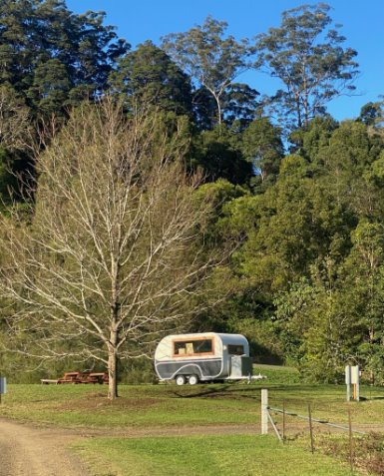
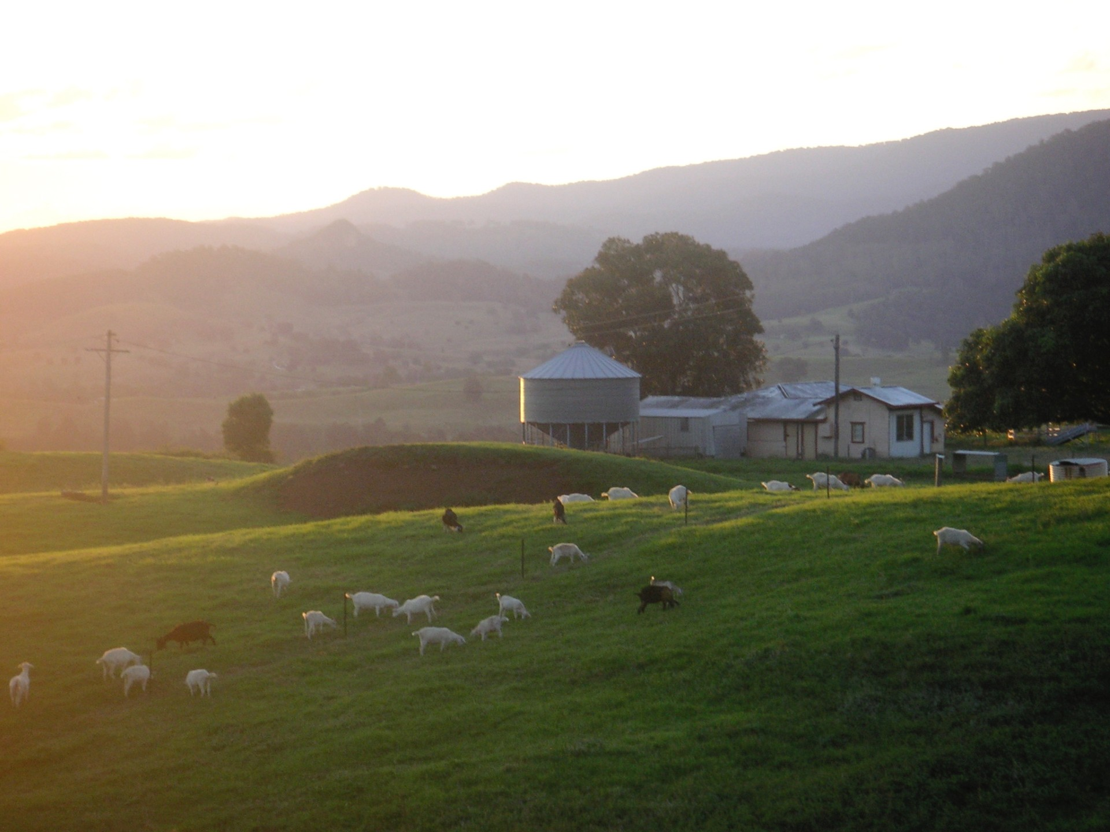
Notes:
A liquor licence is required to sell alcohol in most situations, however there are some limited circumstances when a licence is not needed.
B&Bs/farm stays are exempt if no public restaurant.
f you provide non-potable (town) water to guests or cook with it you will be required to have a NSW Health approved Quality Assurance Plan for a private water supply.

Slide 21
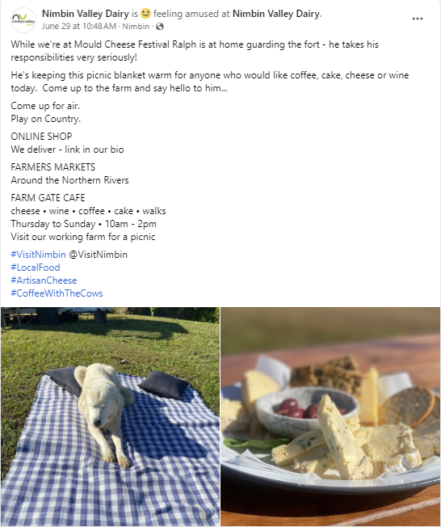
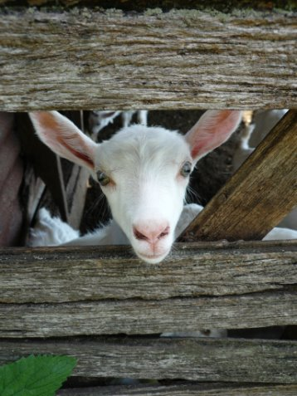
Notes:
A liquor licence is required to sell alcohol in most situations, however there are some limited circumstances when a licence is not needed.
B&Bs/farm stays are exempt if no public restaurant.
f you provide non-potable (town) water to guests or cook with it you will be required to have a NSW Health approved Quality Assurance Plan for a private water supply.

Slide 22
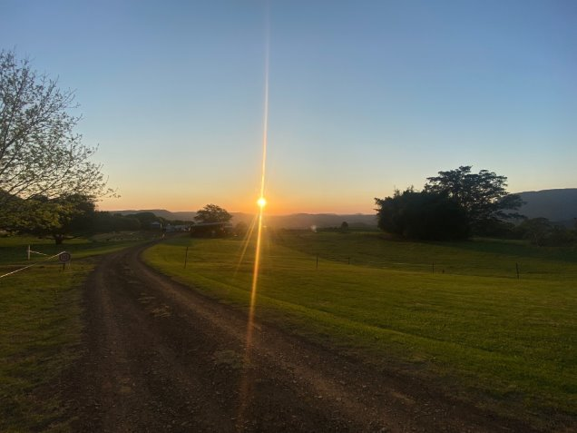
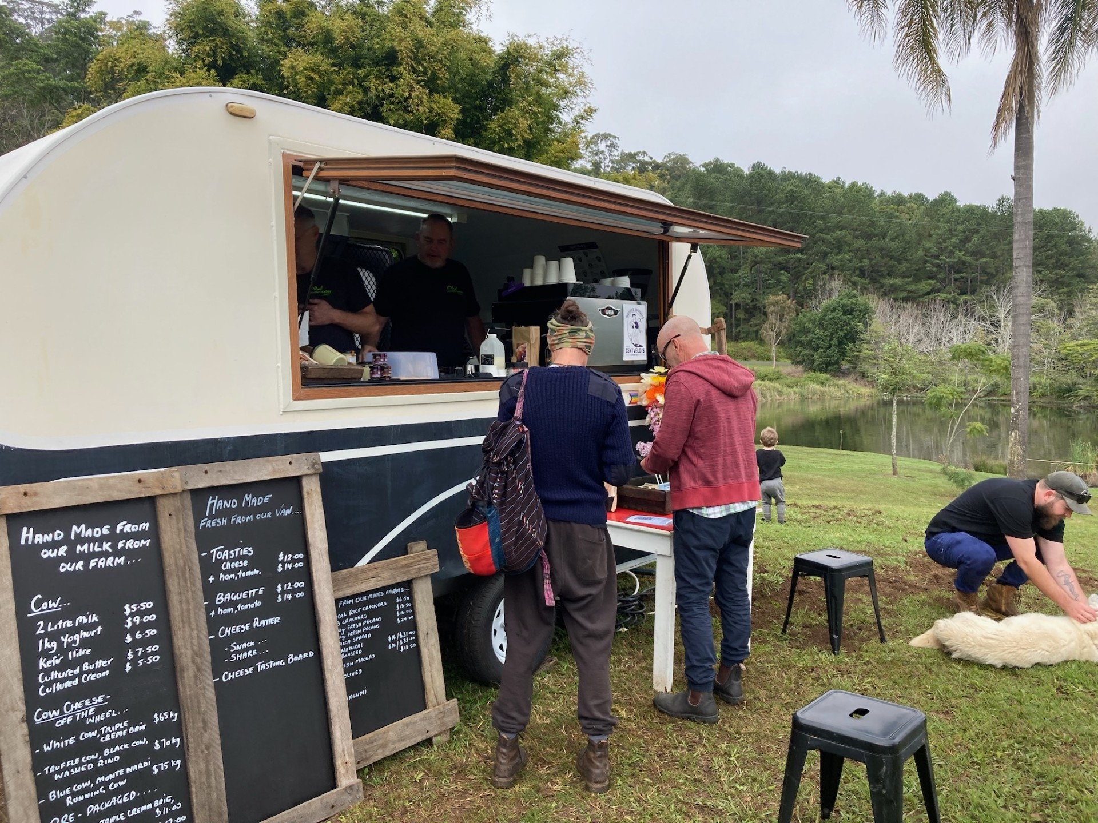
Notes:
A liquor licence is required to sell alcohol in most situations, however there are some limited circumstances when a licence is not needed.
B&Bs/farm stays are exempt if no public restaurant.
f you provide non-potable (town) water to guests or cook with it you will be required to have a NSW Health approved Quality Assurance Plan for a private water supply.

Slide 23
Upcoming Business Education Sessions:
Wednesday 28 August 2024
Northern Rivers Rail Trail Business Ready Workshop: 7:30am - 9:00am
Northern Rivers Rail Trail Developing Your Business Ideas Workshop: 10:00am - 12:30pm
Gordon Pavilion, bookings essential.
Notes:
A liquor licence is required to sell alcohol in most situations, however there are some limited circumstances when a licence is not needed.
B&Bs/farm stays are exempt if no public restaurant.
f you provide non-potable (town) water to guests or cook with it you will be required to have a NSW Health approved Quality Assurance Plan for a private water supply.

Slide 24
Need more assistance?
Lismore City Council Business Concierge Service
Every second Thursday of the month from 8:30am - 10:30am
Bookings via: business@lismore.nsw.gov.au
Notes:
A liquor licence is required to sell alcohol in most situations, however there are some limited circumstances when a licence is not needed.
B&Bs/farm stays are exempt if no public restaurant.
f you provide non-potable (town) water to guests or cook with it you will be required to have a NSW Health approved Quality Assurance Plan for a private water supply.

Slide 25
For further business support contact:
Tina Irish, Manager Destination and Economy
Phone: 02 6625 0458 / 0427 003 645
Business@lismore.nsw.gov.au
Notes:
A liquor licence is required to sell alcohol in most situations, however there are some limited circumstances when a licence is not needed.
B&Bs/farm stays are exempt if no public restaurant.
f you provide non-potable (town) water to guests or cook with it you will be required to have a NSW Health approved Quality Assurance Plan for a private water supply.

